Slide 1

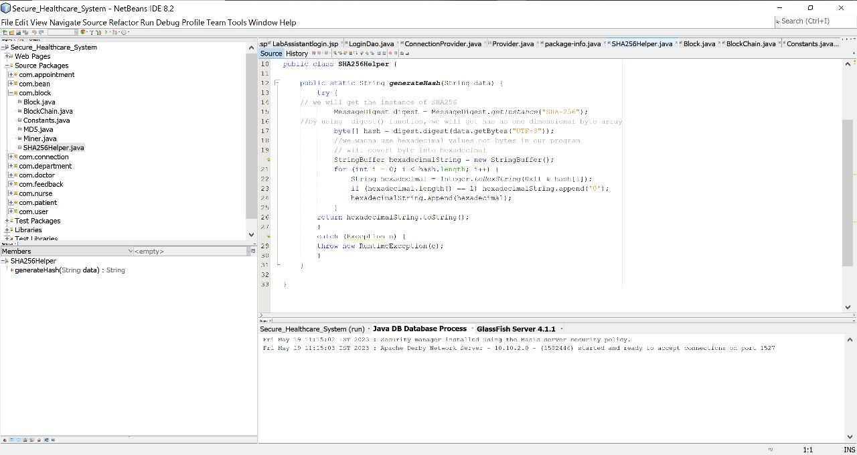
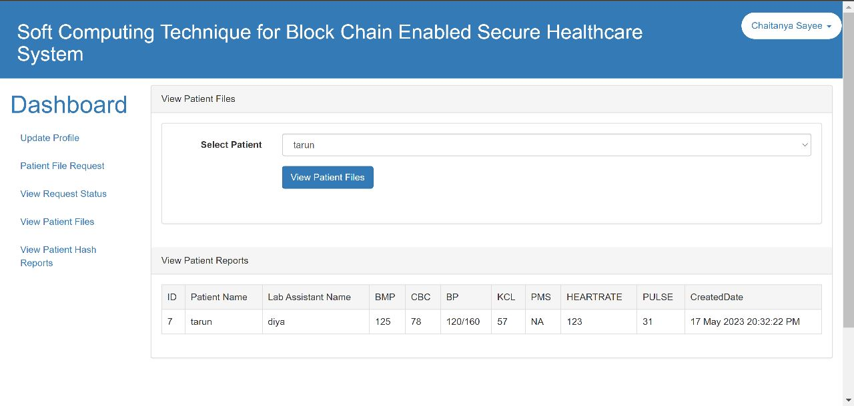
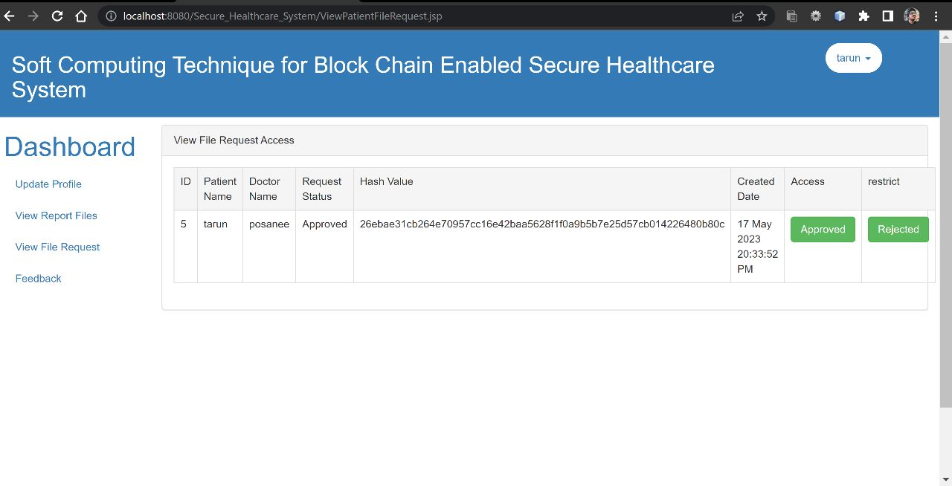
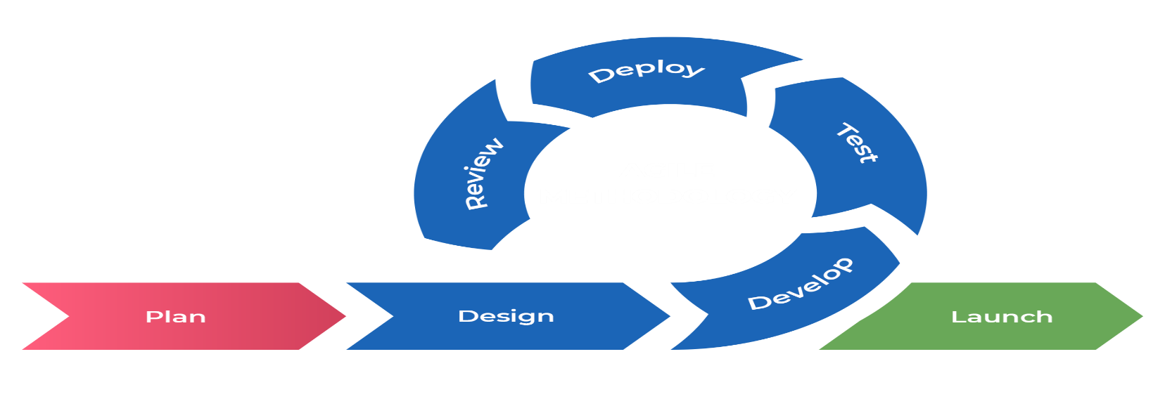
Cardiovascular Patients Data Management In Hospitals Using Cloud Computing
Talasila Tarun, Diya Aryal, Chaitanya Sayee | Dr. Perepi Rajarajeswari | SCOPE
Introduction
Results
The Hospital Management System is intended for any Hospital to switch their current manual, paper-based system. The purpose of our system is to make hospital task easy and is to develop software that replaces the manual hospital system into automated hospital management system. Based on patients data with cardiovascular disease, using SHA 256 technique, the data is stored in secured form in the cloud. The aim is to store the effectiveness of these methods in modelling the effectiveness of predicting mortality in patients with cardiovascular disease.
The implementation of the Hospital Management System (HMS) has yielded significant positive results for the hospital. The integration of the SHA-256 technique for data encryption has ensured the security and integrity of patient information, protecting it from unauthorized access or tampering. Overall, the implementation of the HMS has transformed hospital management, optimizing resource utilization, improving patient care outcomes, and reinforcing data security measures.
Motivation
The motivation behind this project is that it brings numerous benefits to healthcare organizations. By implementing the HMS, hospitals can enhance patient care through efficient management of medical records and treatment plans. It not only saves time but also reduces errors, enabling healthcare professionals to focus on delivering exceptional care. It is a future-proof solution that enables hospitals in evolving industry demands and provide the highest standard of healthcare management.
SCOPE of the Project
The scope of the Hospital Management System is to provide a comprehensive solution that automates and improves various aspects of hospital administration. Doctors prescribe medications, lab tests, and other necessary treatments based on patients symptoms and health conditions. Nurses will have access to these prescriptions, enabling them to perform the prescribed services efficiently. These facilities are to be provided in a well-organized, cost effective manner, with the objective of reducing the time and resources currently required for such tasks. The project aims to revolutionize healthcare operations, improve patient care, optimize resource utilization, and enhance overall efficiency within the hospital.
Methodology
Our development methodology for the Hospital Management System (HMS) is designed to ensure a systematic and secure user-centric approach throughout the project lifecycle.
Firstly, we conducted thorough discussions with hospital administrators, medical professionals, and staff, to gather detailed requirements. We Identified their specific needs, pain points, and desired functionalities for the HMS. Additionally, we ensure a strong focus on data security and privacy concerns throughout this phase.
Next, we move into the system design phase. Based on the gathered requirements, we created a comprehensive system design that includes database architecture, user interface design, and workflow processes. During this phase, we integrated the SHA-256 technique, a widely used cryptographic hash function, to ensure the security and integrity of patient data. SHA-256 will be employed for encrypting and securely storing sensitive information such as patient records, ensuring that the data remains protected from unauthorized access or tampering.
The development phase follows an agile methodology. We utilized an iterative and agile development approach to build and implement the HMS. We Divided the project into smaller sprints or iterations, focusing on developing core modules such as patient information management, appointment scheduling etc... We implemented the SHA-256 technique within the data storage and retrieval processes, ensuring that all sensitive data is encrypted using this robust cryptographic algorithm.
Throughout the development process, rigorous testing and quality assurance practices are employed to validate the functionality, performance, and security of the HMS. This includes comprehensive unit testing, integration testing, and system testing to identify and address any potential issues or bugs. We Paid special attention to testing the implementation and effectiveness of the SHA-256 technique to verify its integrity in protecting patient data.
Once the HMS is deployed, we regularly monitor the system's performance, security measures, and data integrity. We stay updated with the latest advancements in data security and privacy practices, including updates to the SHA-256 algorithm, and incorporate any necessary updates or improvements to ensure the continued protection of patient data.
By following this methodology, incorporating the SHA-256 technique for data encryption and ensuring a strong focus on data security and privacy, the HMS project can achieve a high level of security and integrity in managing patient information, while effectively streamlining hospital operations and improving patient care outcomes.
Conclusion
In conclusion, the Hospital Management System project presents a transformative solution to revolutionize healthcare management.By automating and streamlining critical hospital functions, it aims to enhance cardiovascular patient care, optimize resource utilization, and improve overall efficiency. The project encompasses digitizing patient information, streamlining room allocation and staff scheduling, and facilitating seamless communication between healthcare professionals.
With a strong emphasis on data security, the HMS ensures that patient information remains confidential and protected, providing a reliable and secure platform for managing hospital operations. It sets the stage for a more efficient and patient-centric approach to hospital operations, paving the way for enhanced healthcare delivery and success in the rapidly evolving healthcare landscape. The future of healthcare is data-driven, and the HMS project sets the foundation for a more advanced and patient-centric approach to hospital administration.
References
[1] Z. Liu, "Design and Implementation of Hospital Emergency Nursing Information Management System," GB. Koyuncu and H. Koyuncu, "Intelligent Hospital Management System (IHMS),"
[2] Healthcare management system and domain search of nearest medical services by Ruchi Dumbre, Purva Raut, Bhagyshree mahamuni, Priyanka Khose, Prof.Jagruti Wagh.

